Slide 1


Exceptions & Content Manager

Slide 2

Overview
Exceptions
Content Manager
https://docs.python.org/3/library/exceptions.html

Slide 3

Errors vs Exceptions
An error is an issue that prevents program from completing its task.
Syntax could cause an error
An exception is a condition that interrupts the normal flow of the program
Both are identified at run time
Exceptions can be managed
All exceptions must be instances of a class that derives from BaseException
User code can create subclasses that inherit from an exception type
try to open a filethat does not exist (FileNotFoundError)
try to divide a number by zero (ZeroDivisionError)
try to import a module that does not exist (ImportError)
x = 0
print('hello')
def errr():
if x == 0:
raise ValueError('dont use zero')
print ('this should come next')
errr()

Slide 4
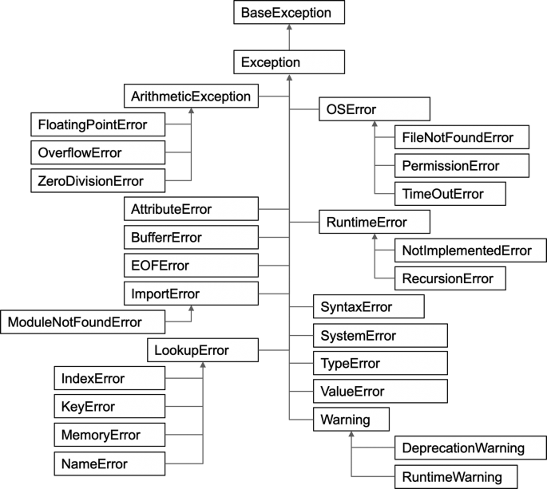
Base Exception

Slide 5


Raising an Exception
hello
---------------------------------------------------------------------------
ValueError Traceback (most recent call last)
<ipython-input-22-0c2513cd5cf0> in <cell line: 7>()
5 raise ValueError('dont use zero')
6 print ('this should come next')
----> 7 errr()
8
<ipython-input-22-0c2513cd5cf0> in errr()
3 def errr():
4 if x == 0:
----> 5 raise ValueError('dont use zero')
6 print ('this should come next')
7 errr()
ValueError: dont use zero
x = 0
print('hello')
def errr():
if x == 0:
raise ValueError('dont use zero')
print ('this should come next')
errr()
Raise an exception that describes
the issue
Traceback
Start at bottom

Slide 6

Try clause
# exceptions/try.syntax.py
def try_syntax(numerator, denominator):
try:
print(f'In the try block: {numerator}/{denominator}')
result = numerator / denominator
except ZeroDivisionError as zde:
print(zde)
else:
print('The result is:', result)
return result
finally:
print('Exiting')
print(try_syntax(12, 4))
Try clause opens statement
An optional Except clause defines action when caught
An optional else clause when no exception
Finally clause used to clean up resources
In the try block: 12/4
The result is: 3.0
Exiting
3.0

Slide 7

Try clause
# exceptions/try.syntax.py
def try_syntax(numerator, denominator):
try:
print(f'In the try block: {numerator}/{denominator}')
result = numerator / denominator
except ZeroDivisionError as zde:
print(zde)
else:
print('The result is:', result)
return result
finally:
print('Exiting')
print(try_syntax(11, 0))
Denominator is 0
ZeroDivisionError occurs
Else block is not executed
Finally block executes before returning None
In the try block: 11/0
division by zero
Exiting
None

Slide 8
Try Try again
# exceptions/multiple.py
values = (1, 0) # try (1, 0) and ('one', 2)
try:
q, r = divmod(*values)
except (ZeroDivisionError, TypeError) as e:
print(type(e),'--------', e)
try:
q, r = divmod(*values)
except ZeroDivisionError:
print("You tried to divide by zero!")
except TypeError as e:
print(e)
Multiple exceptions can be used
The order of the clauses must be
try
except
else
Finally
try must be followed by at least one except clause or a finally clause
<class 'ZeroDivisionError'> -------- integer division or modulo by zero
You tried to divide by zero!

Slide 9
Raise exception within an except clause
# exceptions/replace.py
class NotFoundError(Exception):
pass
vowels = {'a': 1, 'e': 5, 'i': 9, 'o': 15, 'u': 21}
try:
pos = vowels['y'] # try with 'a'
except KeyError as e:
raise NotFoundError(*e.args) # from None
Change to from e or from None
NotFoundError Traceback (most recent call last)
<ipython-input-15-16eb2509c6ab> in <cell line: 6>()
7 pos = vowels['y'] # try with 'a'
8 except KeyError as e:
----> 9 raise NotFoundError(*e.args) # from None
10
11
NotFoundError: y

Slide 10
Using with for Context Managers
# context/manager.class.py
class MyContextManager:
def __init__(self):
print("MyContextManager init", id(self))
def __enter__(self):
print("Entering 'with' context")
return self
def __exit__(self, exc_type, exc_val, exc_tb):
print(f"{exc_type=} {exc_val=} {exc_tb=}")
print("Exiting 'with' context")
return True
ctx_mgr = MyContextManager()
print("About to enter 'with' context")
with ctx_mgr as mgr:
print("Inside 'with' context")
print(id(mgr))
raise Exception("Exception inside 'with' context")
print("This line will never be reached")
print("After 'with' context")
Context managers provide magic methods __enter__() and __exit__() that are invoked on entry to and exit from the body of the with statement
Context managers define an entrance step and an exit step which are run automatically when the with block is entered and exited.
File objects are one type of context manager in Python, and their exit step will automatically close the file.

Slide 11
Standard lib includes contextmanager is the contextlib module
# context/generator.py
from contextlib import contextmanager
@contextmanager
def my_context_manager():
print("Entering 'with' context")
val = object()
print(id(val))
try:
yield val
except Exception as e:
print(f"{type(e)=} {e=} {e.__traceback__=}")
finally:
print("Exiting 'with' context")
print("About to enter 'with' context")
with my_context_manager() as val:
print("Inside 'with' context")
print(id(val))
raise Exception("Exception inside 'with' context")
print("This line will never be reached")
print("After 'with' context")
Assists a class that needs to be acquired and released
Use contextmanager decorator
The decorator wraps the generator in a context manager
__enter__() methods starts the generator and returns the yield
If exception occurs within ‘with’, __exit__() passes exception into generator
Otherwise, __exit__() calls ‘next’ on the generator

Slide 12
Context Manager similar to Try-Finally Block
my_file = open("hola.txt", mode="wt")
try:
my_file.write("Greetings!\n")
finally:
my_file.close()
Assists a class that needs to be acquired and released
Use contextmanager decorator
The decorator wraps the generator in a context manager
__enter__() methods starts the generator and returns the yield
If exception occurs within ‘with’, __exit__() passes exception into generator
Otherwise, __exit__() calls ‘next’ on the generator
with open("goodbye.txt", mode="wt") as my_file:
my_file.write("adios!\n")

